Slide 1

Lecture-1
Introduction to JavaScript

Slide 2
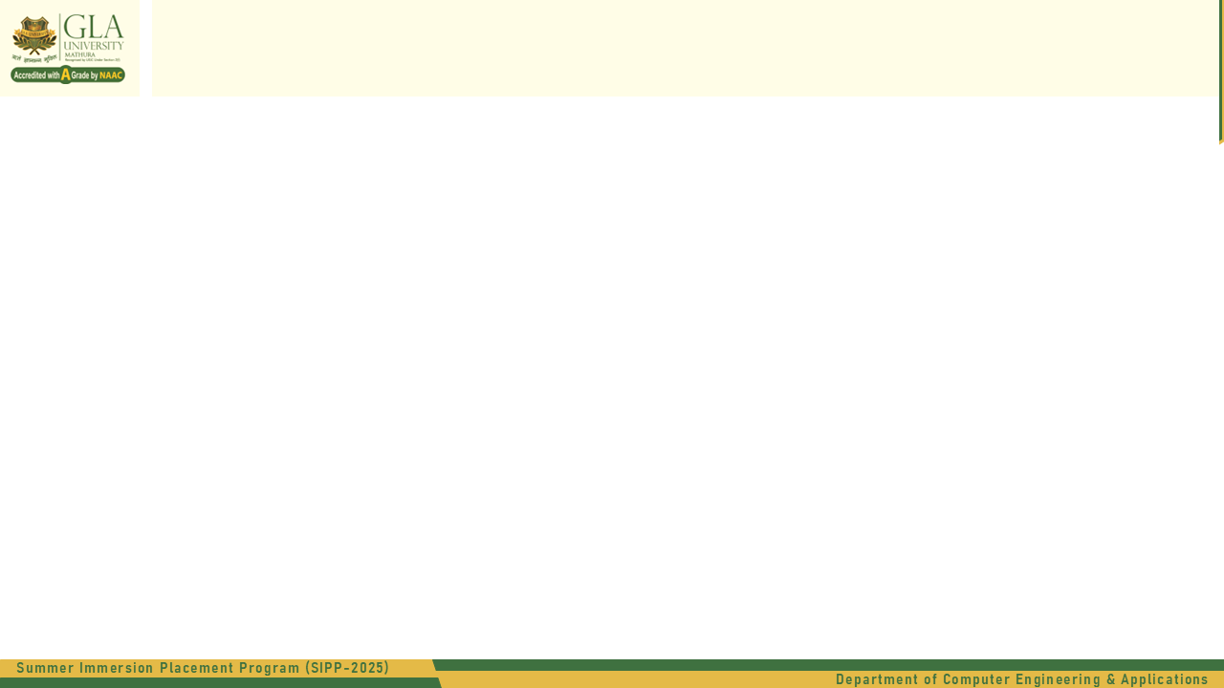
What is JavaScript
JavaScript is a programming language used to create dynamic content for websites.
It is a lightweight, cross-platform, and single-threaded programming language.
It's an interpreted language that executes code line by line, providing more flexibility.

Slide 3
JavaScript Data Types
Data Types:
Number
String
Boolean
Null
Undefined
Object

Slide 4
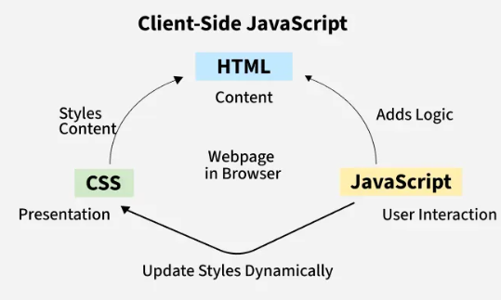
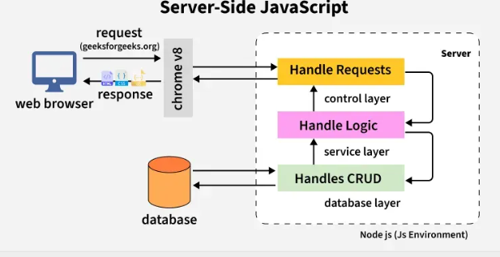
Client-Side JavaScript & Server-side JavaScript

Slide 5

First JavaScript Code
2.External JavaScript Linking <!DOCTYPE html> <html> <head> <title>My First JavaScript </title> </head> <body> <script src="script.js"></script> </body> </html>
There are two ways to write JavaScript code:
Internal Script
External Script
1.Internal JavaScript Linking
<!DOCTYPE html> <html> <head> </head> <body> <script> ---write JavaScript Logic Here---- </script> </body> </html>

Slide 6
Selectors in JavaScript
A selector in JavaScript helps you find an HTML element in the document (DOM – Document Object Model).
Types of Selectors in JavaScript:
getElementById()
getElementsByClassName()
getElementsByTagName()
querySelector()
querySelectorAll()

Slide 7
Star Pattern
Square Star Pattern
*****
*****
*****
*****
*****
Right Triangle Pattern Right-Aligned Triangle
* *
** **
*** ***
**** ****
*****

Slide 8
Star Pattern
3. Inverted Right Triangle
*****
****
***
**
*
4. Pyramid Pattern
*
***
*****
*******
*********

Slide 9
Star Pattern
5. Inverted Pyramid
*********
*******
*****
***
*
6. Diamond Pattern *
***
*****
*******
*********
*******
*****
***
*

Slide 10
Star Pattern
7. Hollow Square Pattern
*****
* *
* *
* *
*****
8. Hollow Pyramid Pattern
*
* *
* *
* *
********

Slide 11
Star Pattern
9. Sandglass Pattern
*********
*******
*****
***
*
***
*****
*******
*********

